Slide 1
Privacy
ELEG 491 Spring 2020
Notes:
Lecture 1: slides 1-11
Lecture 2: slides 12-30

Slide 2
Rights-based theories give us “lists” of rights (e.g., the right to privacy) that could be:
Negative right: an enforceable claim such that, if X possesses some good G, then all others must refrain from harming or diminishing (etc.) G. If the right is infringed, X must be “made whole” again.
Positive right: an enforceable claim such that X must be given (some amount of) G, after which point X also gains a negative right to G.

Slide 3
An model for the moral right of privacy can be borrowed from the legal right of privacy
“The right of the people to be secure in their persons, houses, papers, and effects, against unreasonable searches and seizures, shall not be violated, and no Warrants shall issue, but upon probable cause, supported by Oath or affirmation, and particularly describing the place to be searched, and the persons or things to be seized.”
4th Amendment to the U.S. Constitution

Slide 4
Is this sufficient? Let’s think about the legal right to privacy
What does this conception of privacy proscribe?
What does it prescribe?
Is it a “positive” or a “negative” right?
Should there be a “right to be forgotten” as in the E.U.?

Slide 5
So, if you were to write a journal entry on privacy, it might look like this:
Start with a good news article about IT and privacy

Slide 6
Summarize the what is at issue in the article!
“Snapchat is a social networking app that was started in 2011. It gained popularity primarily because images sent with text messages did not remain on the server and hence “disappeared” once they were viewed. Now Snapchat has changed their Terms of Service, telling users that the company reserves the right to “reproduce, modify and republish” users’ photos….”

Slide 7
Then make sure to provide your own analysis of the article, and (optimally) connect it back to the lecture/readings for the week
“It may seem that the new Snapchat policy violates users’ privacy. But is not clear that an image or text, sent on a social networking site, is part of someone’s “persons, papers, houses, or effects.” Furthermore, the user does not have to use Snapchat. But if they want to, they must agree to the Terms of Service. So we think that the claim of a “violation of privacy” is overblown here.”

Slide 8
Is there a moral right to privacy?
Such a right could mean several things:
Freedom from unwarranted intrusion
Freedom from interference in personal affairs or personal decisions
Freedom to control the flow of personal information.

Slide 9
What do some leading IT “innovators” think about privacy? Consider Scott McNealy (Sun Microsystems)
(1999) Consumer privacy issues are a “red herring,” McNealy told a group of reporters that year. “You have zero privacy anyway. Get over it.”
(2015) “It doesn’t really bother me that Google and AT&T have information about me, because I can always switch to another provider... If Uber starts screwing around with my data, I’ll use Lyft…. [but] It scares me to death when the NSA or the IRS know things about my personal life and how I vote.”
https://www.pcworld.com/article/2941052/scott-mcnealy-on-privacy-you-still-dont-have-any.html

Slide 10
Is McNealy’s view based on rights claims?
What other kinds of ethical considerations might influence privacy issues?
Communitarianism
Utilitarianism

Slide 11
Decisions and Intrusions (Constitutional Privacy)
The interference/intrusion views of privacy see it as either:
being let alone, (Warren & Brandeis, 1890)
being free from government intrusion (e.g., into one’s physical space).

Slide 12
“Tort” view about the flow of information
Appropriateness of others getting info. @ you
Technology governing access/distribution
Laws (statutory and common law) about injury

Slide 13
What does revealing (digitized) information about a person threaten?
The security of the:
1. person
2. house
3. papers
4. effects
???

Slide 14
What do we gain by giving up privacy?
Think about the contexts in which people allow information about themselves to “flow” to others

Slide 15
Van den Hoven on “Reductionist” views of privacy
It is not privacy we’re trying to protect, but “property rights, security, autonomy, intimacy or friendship, democracy, liberty, dignity, or utility and economic value.”

Slide 16
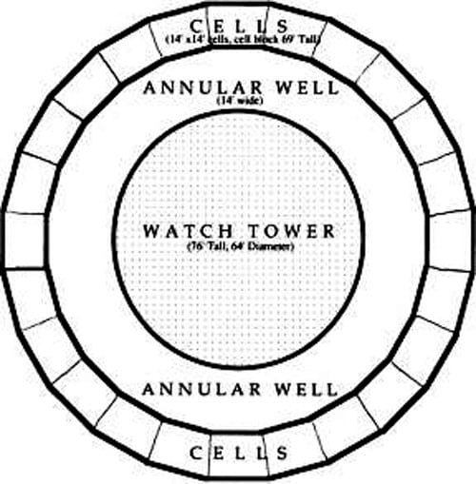
Epistemic (relational) view of privacy
“Having privacy means that others don't know certain private propositions.”
Cf. Bentham’s
“Panopticon”

Slide 17
Some technical drivers of the IT/Privacy problem
Amount of data that can be cheaply stored
Methods of gathering data
Networks/Connectivity/Flow
Some examples: the Internet, Social Media, Big Data, Mobile Devices, Internet of Things, E-Gov’t

Slide 18
New technologies as threats to privacy
Sensors on the nanoscale
Ambient IT
Genome sequencing
Facial recognition software
and…

Slide 19
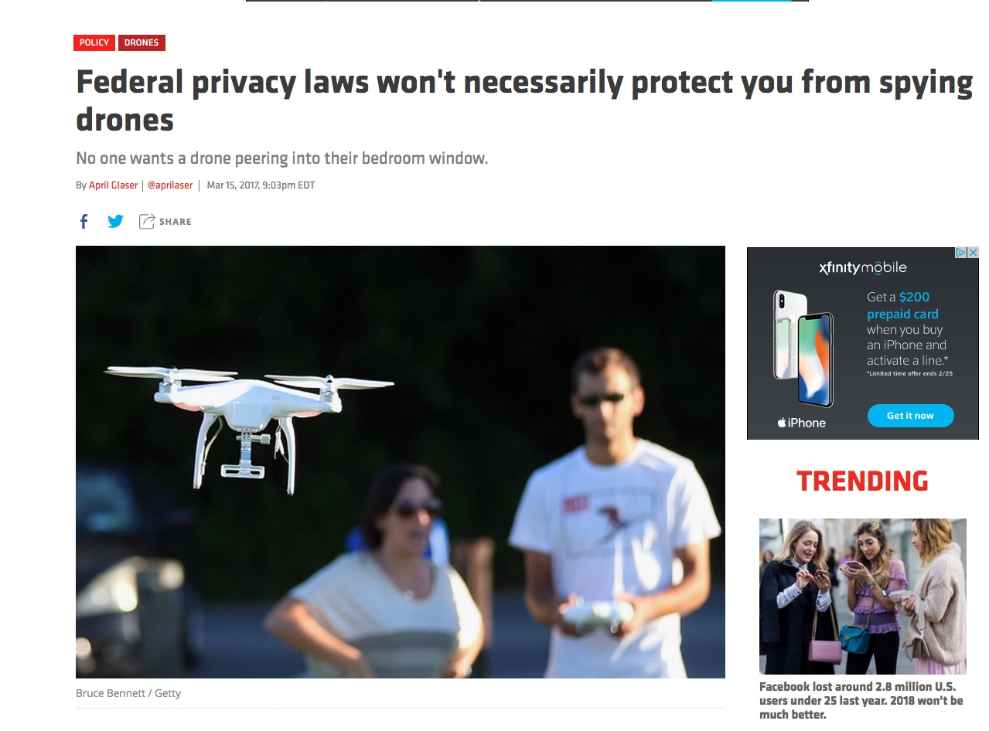
Drones!
https://www.recode.net/2017/3/15/14934050/
federal-privacy-laws-spying-drones-senate-hearing

Slide 20
Technological Solutions
Value (Privacy) Sensitive Design
Privacy Enhancing Technologies
(Tor and Proxy Servers, Freenet)
Cryptography, Identity Management
But…doesn’t this require care on “both ends”?

Slide 21
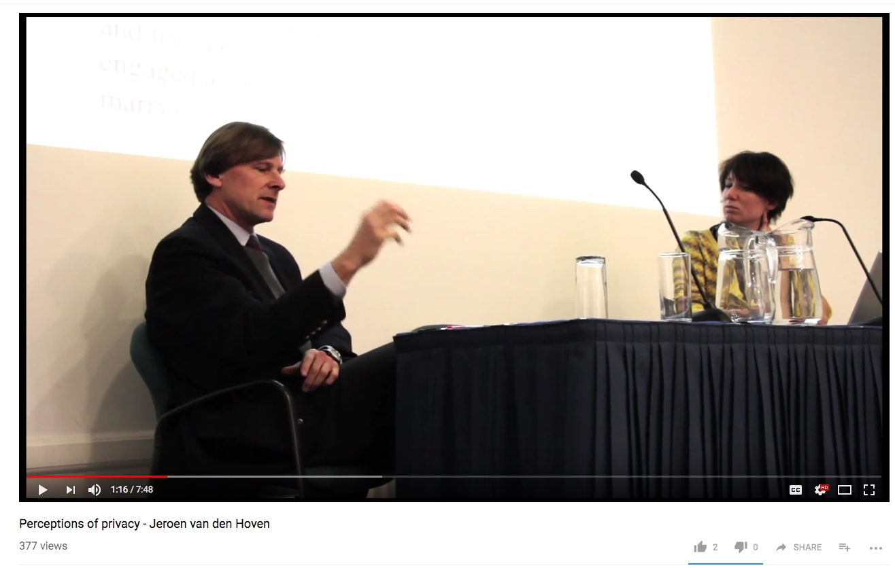
Compare the EU’s data protection approach

Slide 22
Van den Hoven’s “moral reasons for protecting personal data”
Prevention of harm (through impersonation, identity theft, etc.)
Informational inequality (commodification of personal information)
Informational injustice and discrimination (health care and insurance, contracts, employment, etc.)
Encroachment on moral autonomy (outside influence)

Slide 23
Finally, let’s consider a continuum of privacy policies, from the perspective of a designer of a technology
Do anything you want with users’ information
Don’t use information from users at all

